Slide 1
Graph Data Structure
Prepared by: Afaq Mansoor Khan
BSSE III- Group A
Session 2017-21
IMSciences, Peshawar.

Slide 2
Last Lecture Summary
Introduction to AVL tree
Insertion and deletion of a node in AVL tree.
Balancing of Tree
Calculating Height of a particular node in the Tree
Calculating balance Factor for a particular Node in the Tree
Left Rotation in an AVL Tree
Right Rotation in an AVL Tree
All types of Traversals in AVL
Algorithm Analysis

Slide 3
Objectives Overview
Introduction to Graph Data Structure.
Depth First Traversal In Graph
Breadth First Traversal in Graph

Slide 4
Graph Data Structure
A Graph is a non-linear data structure consisting of nodes and edges. The nodes are sometimes also referred to as vertices and the edges are lines or arcs that connect any two nodes in the graph. More formally a Graph can be defined as:
A Graph consists of a finite set of vertices(or nodes) and set of Edges which connect a pair of nodes.

Slide 5
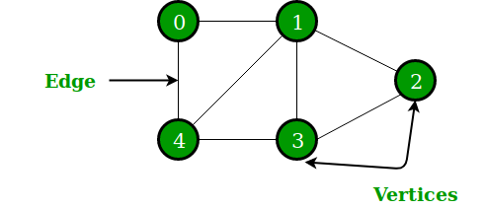
In the above Graph, the set of vertices V = {0,1,2,3,4} and the set of edges E = {01, 12, 23, 34, 04, 14, 13}.

Slide 6
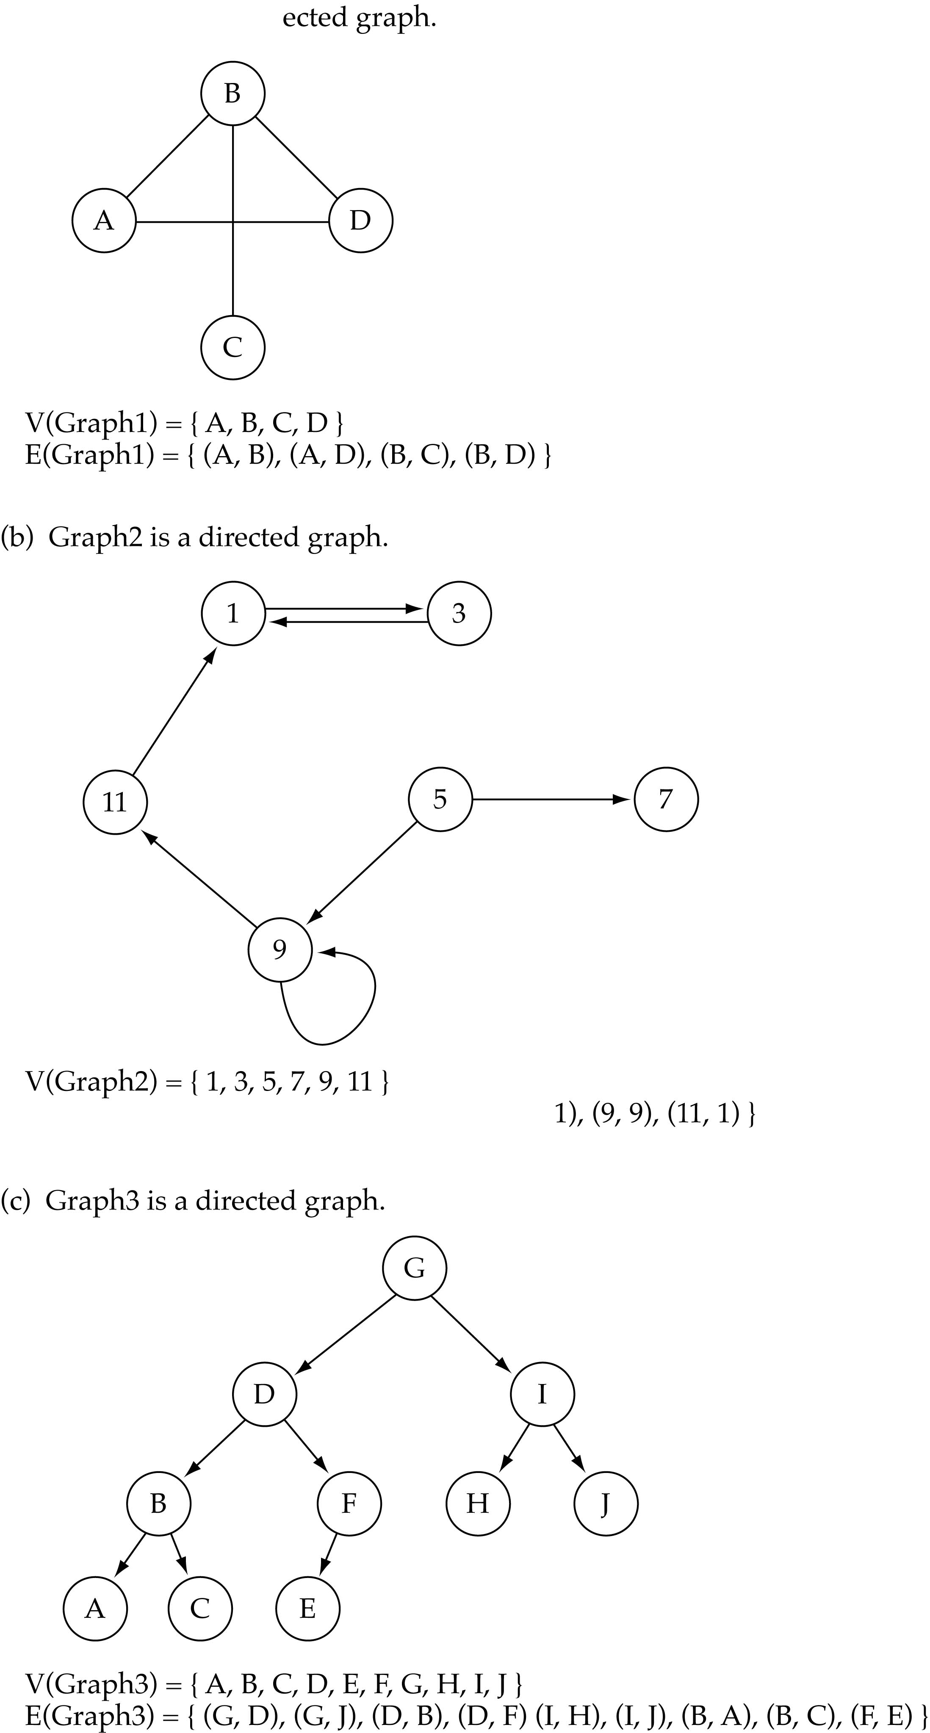
Directed vs. undirected graphs
When the edges in a graph have no direction, the graph is called undirected

Slide 7
Directed vs. undirected graphs
When the edges in a graph have a direction, the graph is called directed (or digraph)
Warning: if the graph is directed, the order of the vertices in each edge is important !!
E(Graph2) = {(1,3) (3,1) (5,9) (9,11) (5,7)

Slide 8
Trees vs graphs
Trees are special cases of graphs!!

Slide 9
Graph terminology
Adjacent nodes: two nodes are adjacent if they are connected by an edge
Path: a sequence of vertices that connect two nodes in a graph
Complete graph: a graph in which every vertex is directly connected to every other vertex
5 is adjacent to 7
7 is adjacent from 5

Slide 10
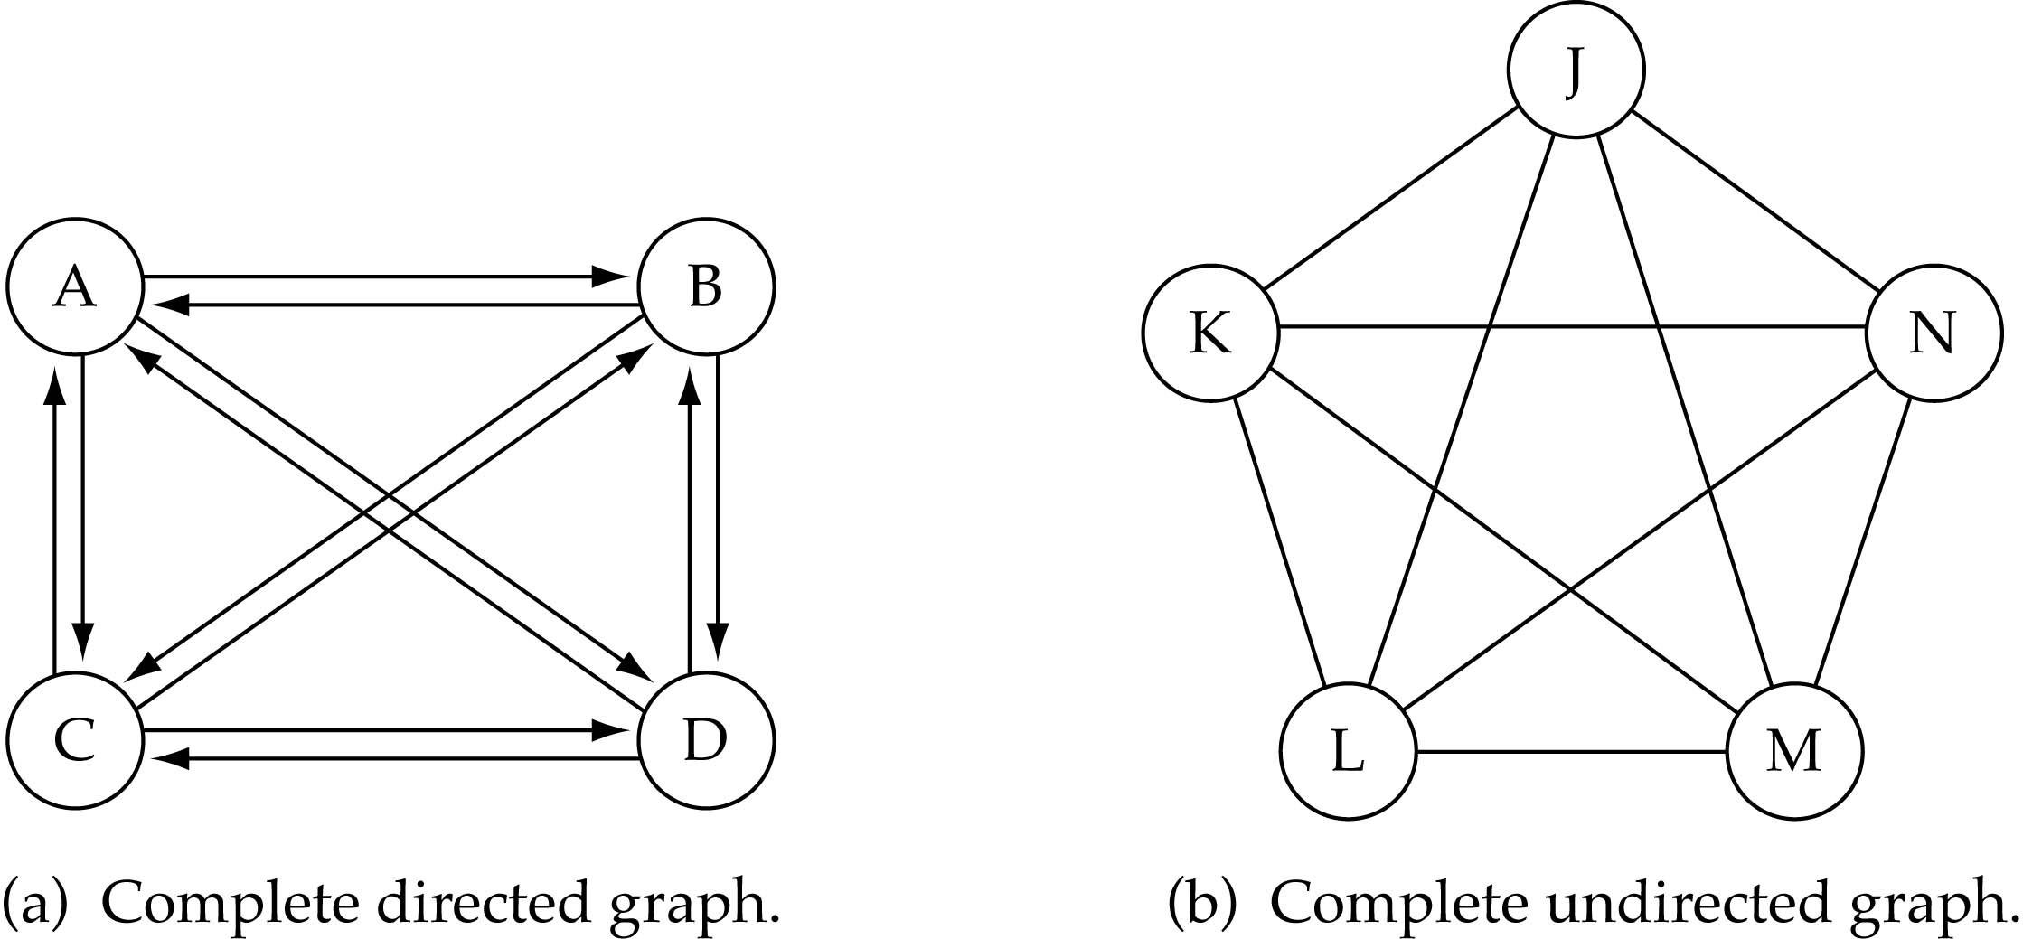
Graph terminology
What is the number of edges in a complete directed graph with N vertices?
N * (N-1)

Slide 11
Graph terminology
What is the number of edges in a complete undirected graph with N vertices?
N * (N-1) / 2

Slide 12
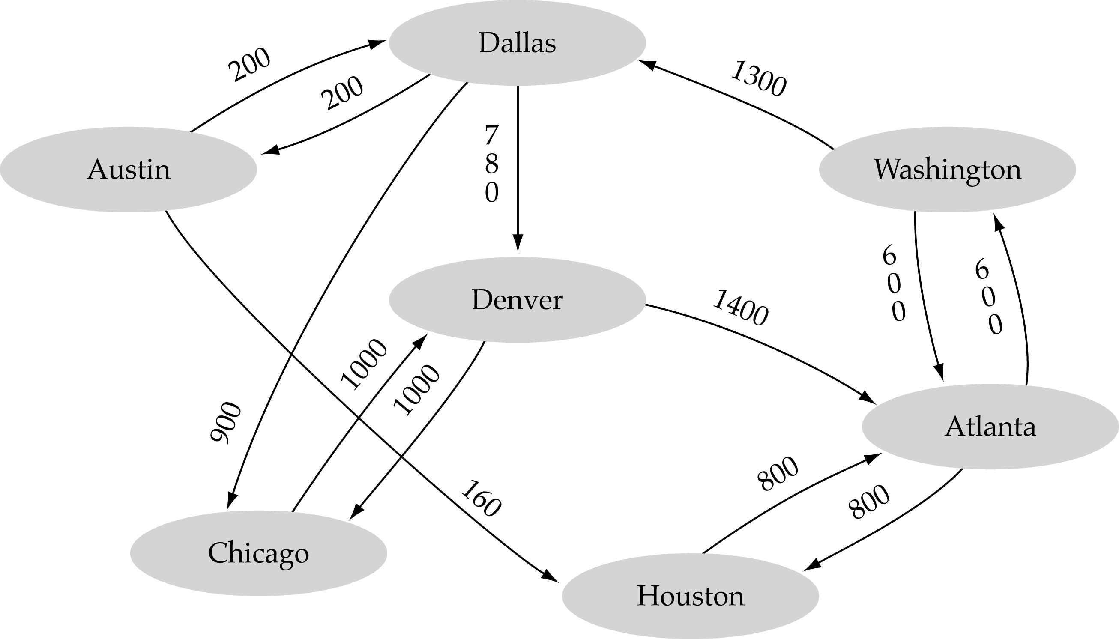
Graph terminology
Weighted graph: a graph in which each edge carries a value

Slide 13
Graph implementation
Array-based implementation
A 1D array is used to represent the vertices
A 2D array (adjacency matrix) is used to represent the edges

Slide 14
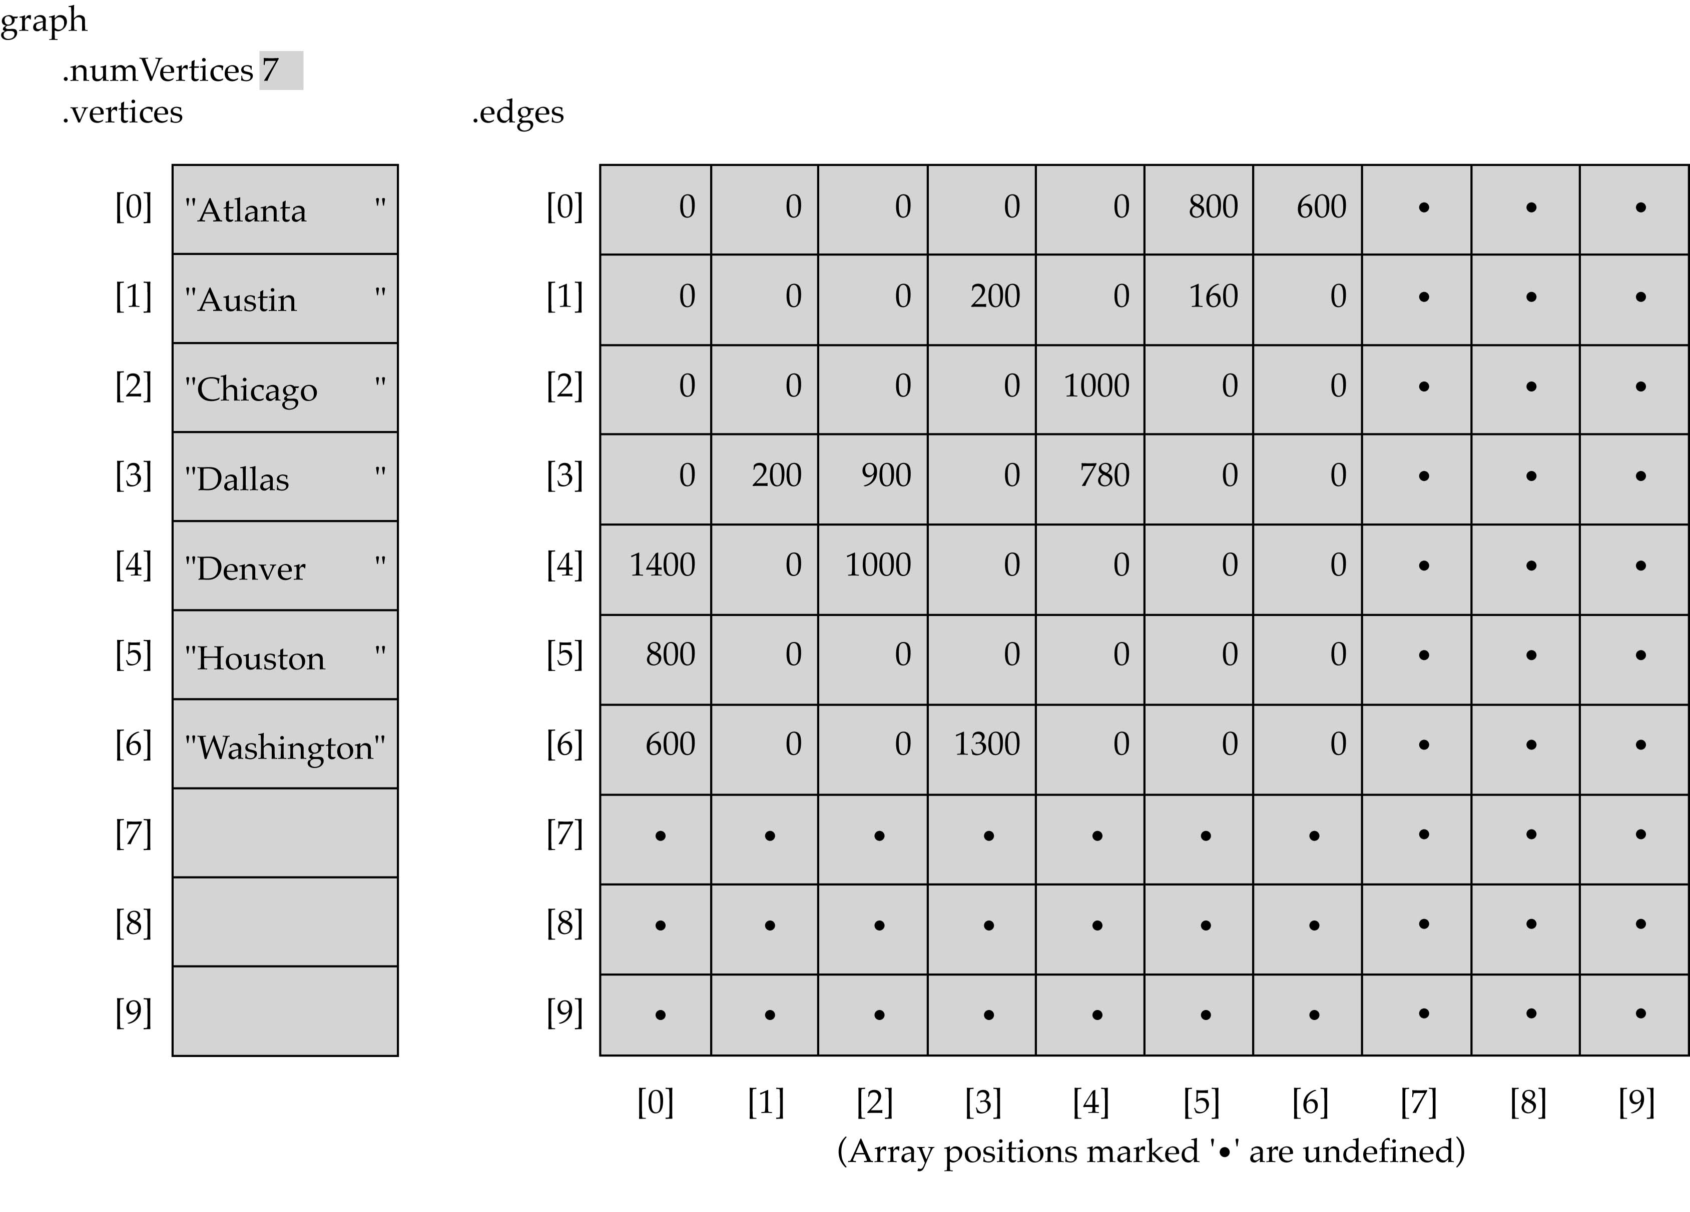
Array-based implementation

Slide 15
Graph implementation
Linked-list implementation
A 1D array is used to represent the vertices
A list is used for each vertex v which contains the vertices which are adjacent from v (adjacency list)

Slide 16
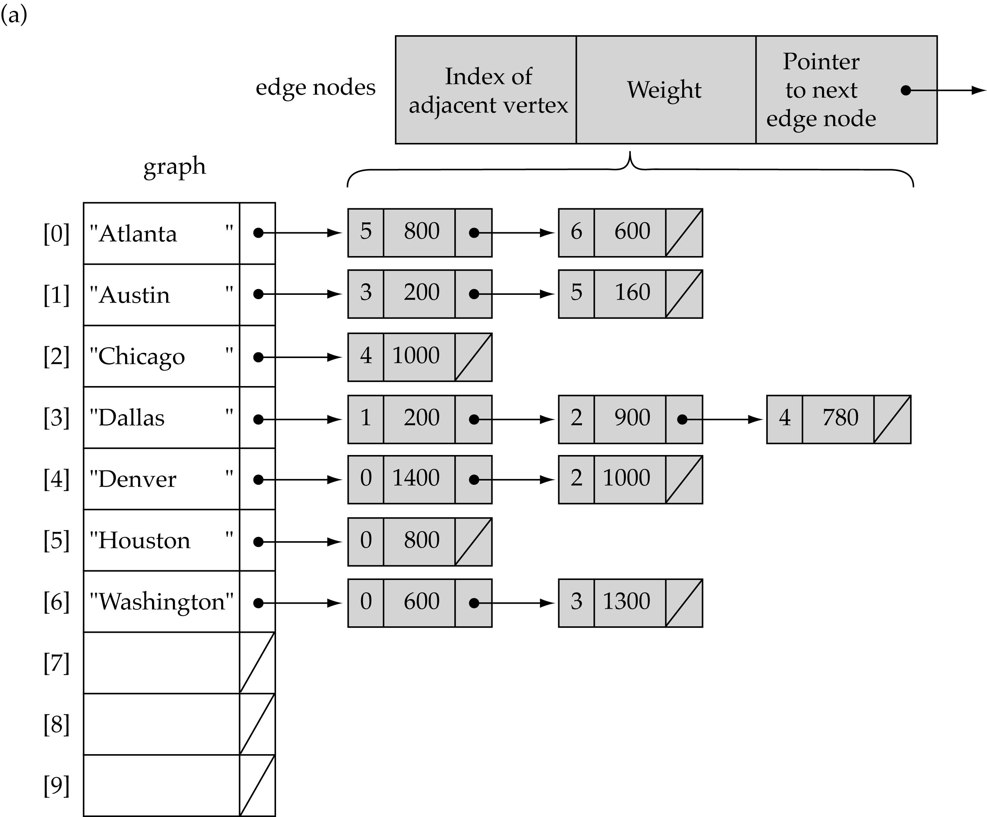
Linked-list implementation

Slide 17
Adjacency matrix vs. adjacency list representation
Adjacency matrix
Good for dense graphs --|E|~O(|V|²)
Memory requirements: O(|V| + |E| ) = O(|V|² )
Connectivity between two vertices can be tested quickly
Adjacency list
Good for sparse graphs -- |E|~O(|V|)
Memory requirements: O(|V| + |E|)=O(|V|)
Vertices adjacent to another vertex can be found quickly

Slide 18
Graph searching
Problem: find a path between two nodes of the graph (e.g., Austin and Washington)
Methods: Depth-First-Search (DFS) or Breadth-First-Search (BFS)

Slide 19
Depth-First-Search (DFS)
What is the idea behind DFS?
Travel as far as you can down a path
Back up as little as possible when you reach a "dead end" (i.e., next vertex has been "marked" or there is no next vertex)
DFS can be implemented efficiently using a stack

Slide 20
Depth-First-Search (DFS)
Set found to false
stack.Push(startVertex)
DO
stack.Pop(vertex)
IF vertex == endVertex
Set found to true
ELSE
Push all adjacent vertices onto stack
WHILE !stack.IsEmpty() AND !found
IF(!found)
Write "Path does not exist"

Slide 21
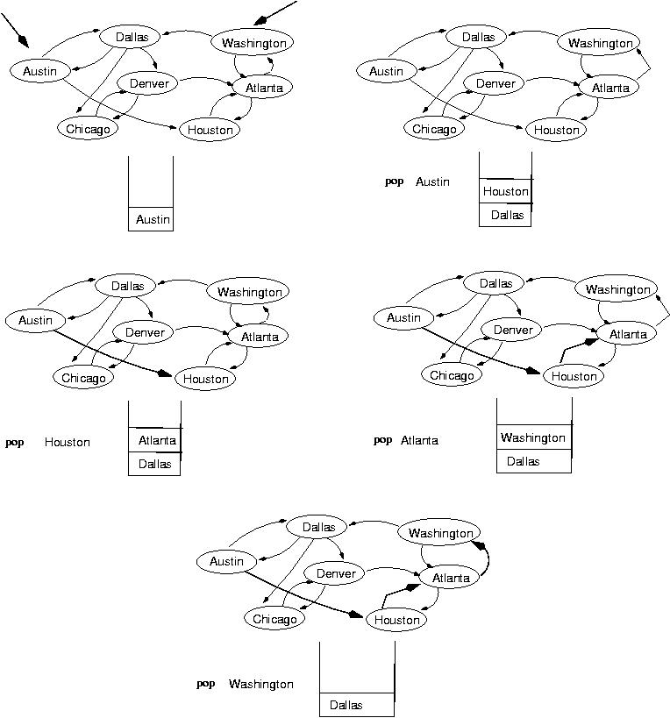
start
end
(initialization)

Slide 24
Breadth-First-Searching (BFS)
What is the idea behind BFS?
Look at all possible paths at the same depth before you go at a deeper level
Back up as far as possible when you reach a "dead end" (i.e., next vertex has been "marked" or there is no next vertex)

Slide 25
Breadth-First-Searching (BFS)
BFS can be implemented efficiently using a queue
Set found to false
queue.Enqueue(startVertex)
DO
queue.Dequeue(vertex)
IF vertex == endVertex
Set found to true
ELSE
Enqueue all adjacent vertices onto queue
WHILE !queue.IsEmpty() AND !found
Should we mark a vertex when it is enqueued or when it is dequeued ?
IF(!found)
Write "Path does not exist"

Slide 26
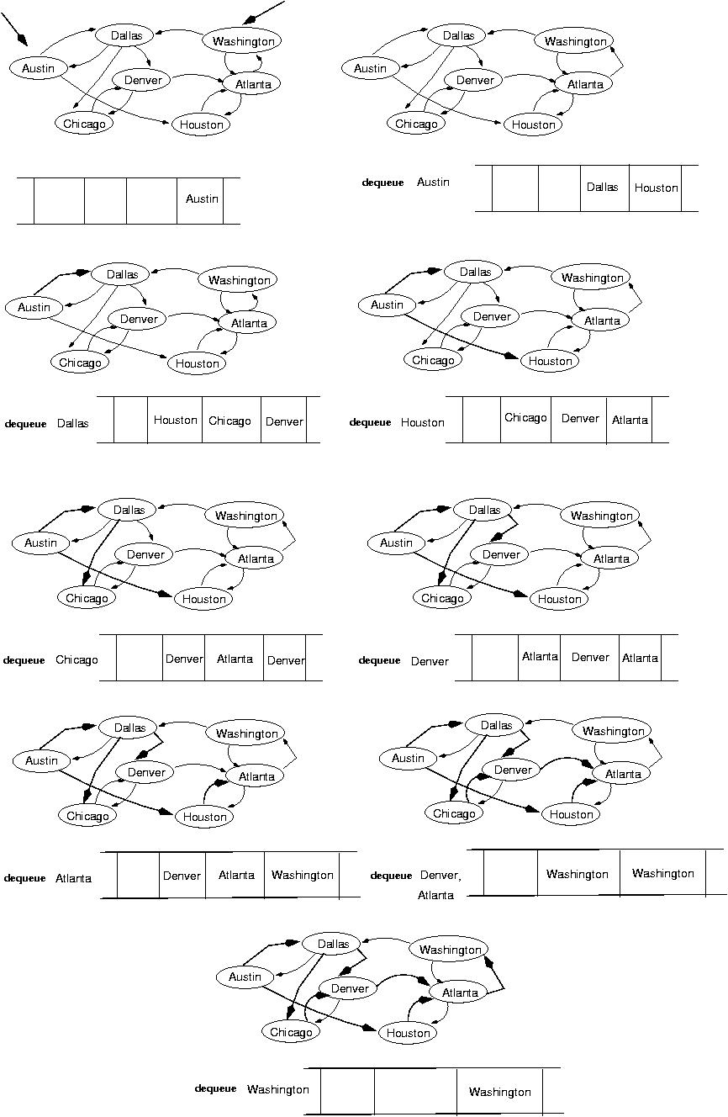
start
end
(initialization)

Slide 27
next:

Slide 29
Single-source shortest-path problem
There are multiple paths from a source vertex to a destination vertex
Shortest path: the path whose total weight (i.e., sum of edge weights) is minimum
Examples:
Austin->Houston->Atlanta->Washington: 1560 miles
Austin->Dallas->Denver->Atlanta->Washington: 2980 miles

Slide 30
Single-source shortest-path problem
Common algorithms: Dijkstra's algorithm, Bellman-Ford algorithm
BFS can be used to solve the shortest graph problem when the graph is weightless or all the weights are the same
(mark vertices before Enqueue)

Slide 31
Summary
Introduction to Graph Data Structure
Terminology
Implementation
Directed graphs
Undirected graphs
Depth First Traversal In Graph
Breadth First Traversal in Graph

Slide 32
References
https://www.geeksforgeeks.org/graph-data-structure-and-algorithms/
www.csie.ntu.edu.tw/~ds/ppt/ch6/chapter6.PPT
https://www.tutorialspoint.com/data_structures_algorithms/graph_data_structure.htm
https://www.programiz.com/dsa/graph
https://www.cse.unr.edu/~bebis/CS308/PowerPoint/Graphs.ppt

